Slide 1
STEP 1 – DEFINE THE PROJECT
Is our app a need, or a want?

Slide 2
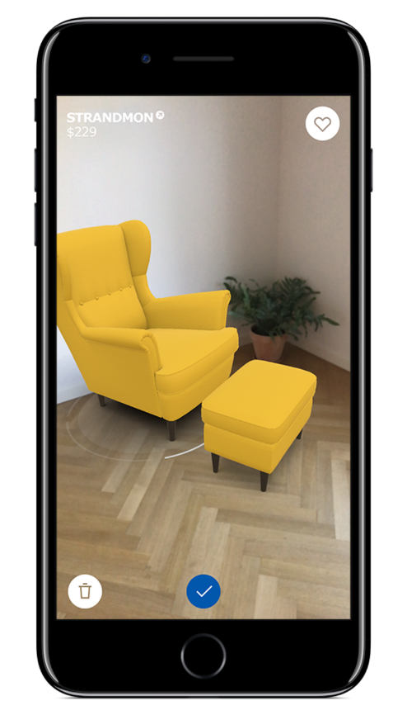
Step 1 Define the Project
Should exist to fix a real-world problem
Booking App - Hair Salon
Product Catalogue - Furniture Store
Food Delivery – Take Away
Therefore every app has a mission
Book on-the-move
Browse at leisure
Track their food

Slide 3
Step 1 Define the Project
So, our mission statement would be:
“To design and build an application that allows our customers to track their deliveries so that they may avoid waiting home for parcels”

Slide 4
CHALLENGE TIME!
Take a real world problem and come up with an application that would solve that problem.
Use your imagination (within reason)
Or, a concept you can continue throughout the course
Next, write a mission statement
For bonus points, get feed back from at least one person on your idea – ways you can do this are:
Share it with the rest of the group on our Slack board and swap ideas and critique each others plans
Or ask a family member or a friend
Post it on Twitter, Reddit, Facebook etc.

